Slide 1
Crowdfunding Analysis

Slide 2
Background
This project is based on the analysis of crowdfunding data to understand how different projects perform on a crowdfunding platform. Crowdfunding is a method where people raise money for their ideas or projects by collecting small amounts from many backers through an online platform.
The dataset used in this project contains information such as:
Project status (successful, failed, canceled)
Project category
Country/location
Funding goal and amount raised
Number of backers
Project creation dates

Slide 3
Project Goals
Analyze Project Outcomes Understand the distribution of successful, failed, and canceled crowdfunding projects.
Identify Top Project Categories Determine the most popular categories and evaluate their performance.
Analyze Location-Based Trends Identify countries with the highest number of crowdfunding projects.
Study Time-Based Trends Analyze project creation patterns by year, quarter, and month.
Calculate Project Success Rate Measure the overall success percentage of crowdfunding projects.

Slide 4
Tools
Excel Used for initial data review, basic cleaning, and validation of results.
Power BI Used to create charts and dashboards for visualizing insights.
Tableau Visualizing crowdfunding data using bar, line, and pie charts.
SQL Used for data extraction, cleaning, and analysis using queries, joins, and aggregations.

Slide 5
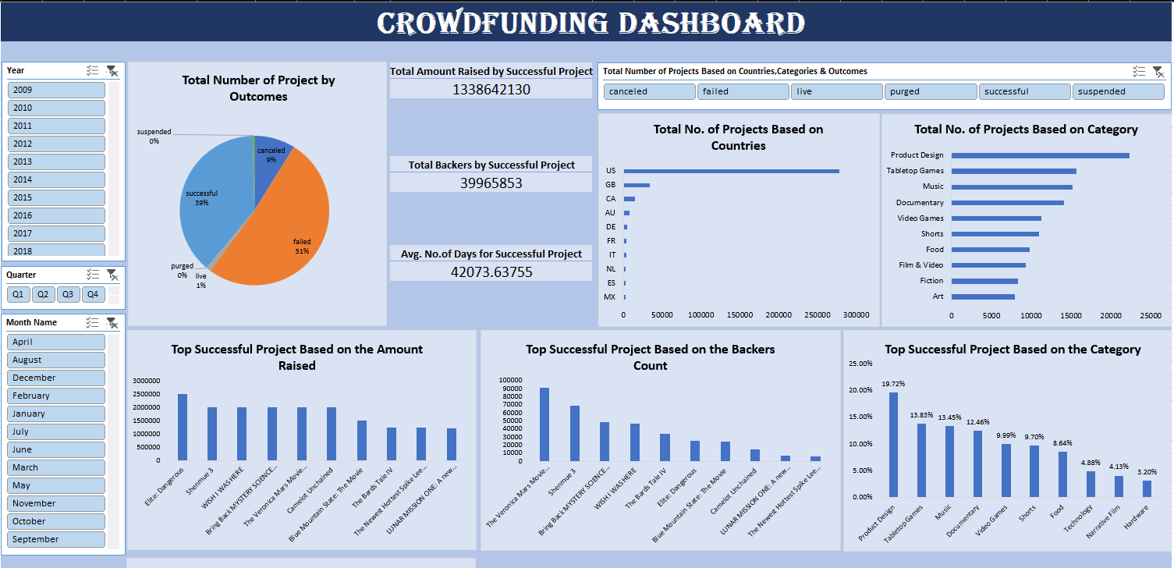
Excel

Slide 6
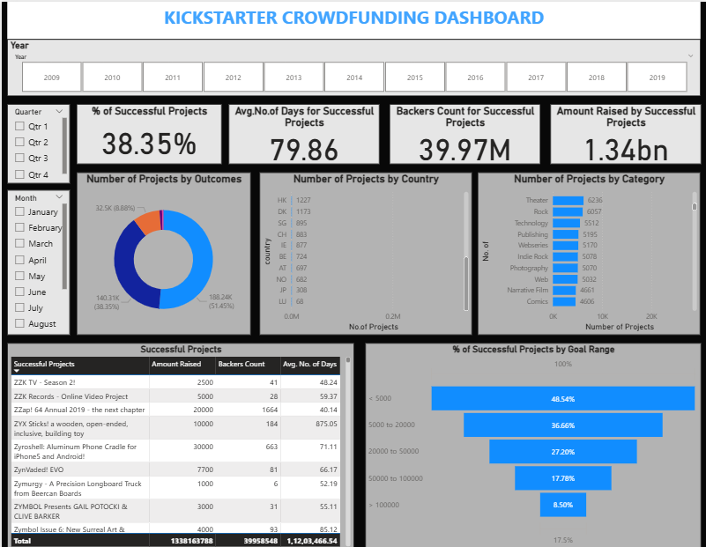
Power BI

Slide 7
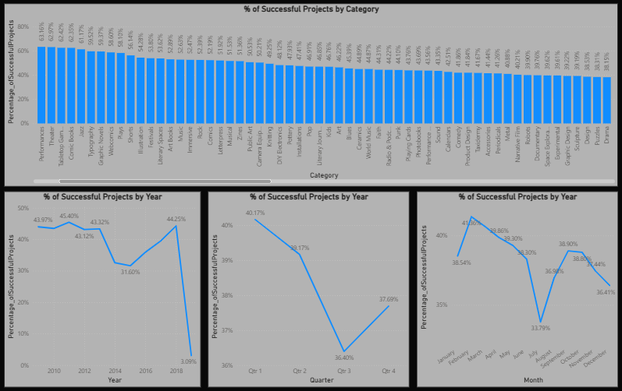

Slide 8
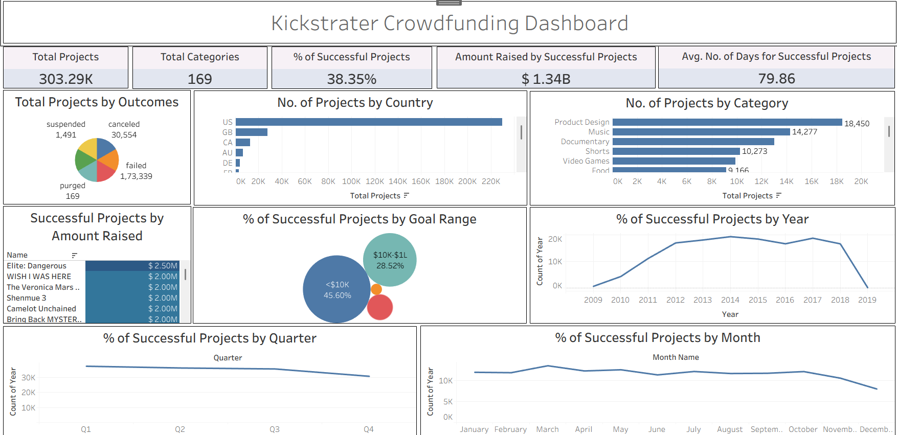
Tableau

Slide 9
Key Insights of the Project
Successful Projects Dominate A significant number of projects achieved successful outcomes compared to failed and canceled projects.
Popular Categories Perform Better Certain categories have a higher number of projects and better success rates, showing strong audience interest.
Top Countries Lead Crowdfunding Activity A few countries contribute the majority of crowdfunding projects, indicating higher platform adoption.
Higher Backer Engagement Improves Success Projects with more backers generally have a higher chance of being successful.
Time-Based Growth Trend Observed The number of projects increased over the years, showing growing interest in crowdfunding platforms.

Slide 10
Challenges Faced in the Project
Improved Data Cleaning Handled missing values, removed duplicates, and corrected inconsistent data formats.
Data Standardization Converted date formats and standardized category and country names.
Step-by-Step SQL Approach Broke complex queries into smaller parts and used optimized joins and aggregations.
Exploratory Data Analysis (EDA) Performed EDA to better understand patterns, trends, and user behaviour.
Effective Visualization Selected appropriate charts and dashboards to clearly present insights.

Slide 11
How We Overcome These Challenges
Data Quality Issues The dataset contained missing values, duplicate records, and inconsistent formats.
Data Cleaning & Preprocessing Cleaning large datasets and standardizing columns required significant time and effort.
Complex SQL Queries Writing and optimizing joins, aggregations, and time-based queries was challenging
Understanding User Behaviour Identifying factors that influence project success was not straightforward.
Visualization Selection Choosing the right charts to clearly represent insights was difficult.

Slide 12
Conclusion
This project helped us understand how crowdfunding projects perform using data analysis. By using SQL, we analyzed project outcomes, categories, locations, and time-based trends.
The analysis showed that project success depends on factors such as category popularity, number of backers, and funding trends over time. Using tools like Power BI and Tableau, we converted raw data into meaningful visual insights.
Overall, this project improved our SQL skills and helped us learn how data can be used to support better decision-making.

Slide 13
Thank You

